Slide 1
Self-Supervised Learning
AI ToolKit
Fall Semester, 2023
Reference: http://cs231n.stanford.edu/slides/2022/lecture_14_jiajun.pdf
https://www.slideshare.net/sangwoomo7/selfsupervised-learning-lecture-note
Notes:
How can summarize matrices, how matrices can be decomposed.

Slide 2
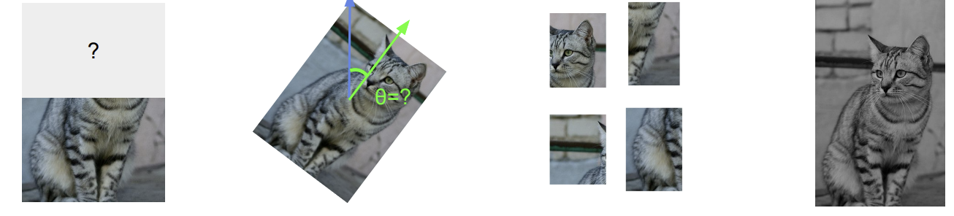
Self-Supervised Learning (SSL)
When a label is made solely by input data, without human’s annotation.
Self-supervised learning methods solve “pretext” tasks that produces good features for downstream tasks.
Pretext Task Example: Learn to predict image transformation / complete corrupted images
Image Completion Rotation Prediction jigsaw puzzle colorization
We can automatically generate labels for the pretext tasks.
Notes:
Learn High-level semantic features with pretext tasks instead.

Slide 3
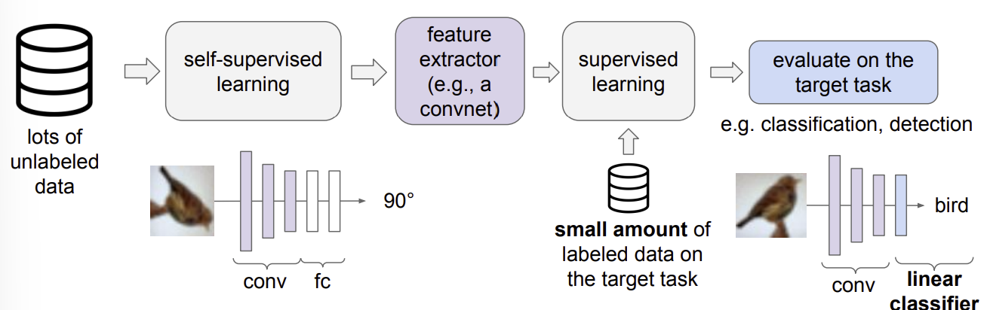
Evaluating Self-Supervised Learning Methods
Learn good feature extractors from self-supervised pretext tasks
Attach a shallow network on the feature extractor
Train the shallow network on the target task with small amount of labelled data

Slide 4
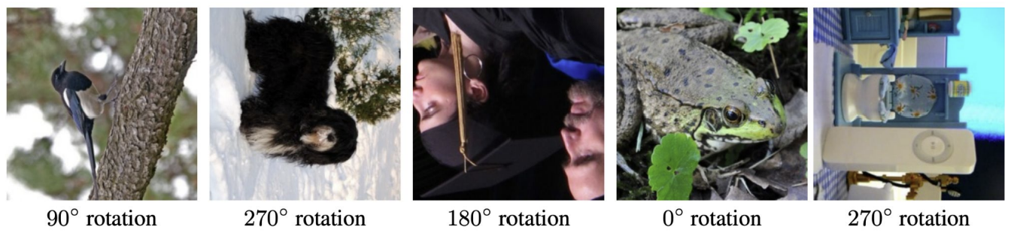
Pretext Task: predict rotations
Main hypothesis:
If the “visual commonsense” of how the object should look like is unperturbed,
a model could recognize the correct rotation of an object.

Slide 5
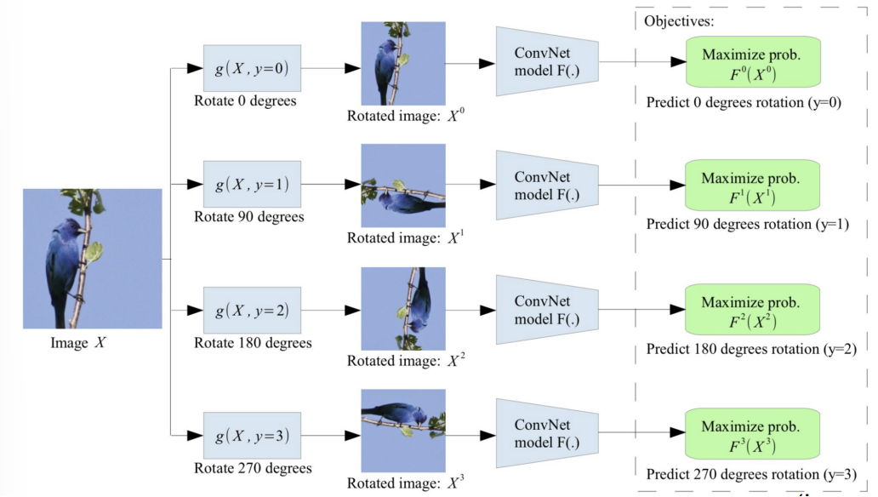
Pretext Task: predict rotations
The model learns to predict which rotation is applied (4-way classification)

Slide 6
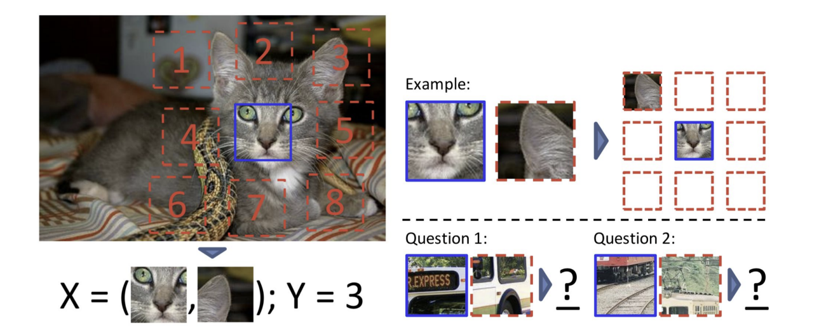
Pretext Task: predict relative patch locations

Slide 7
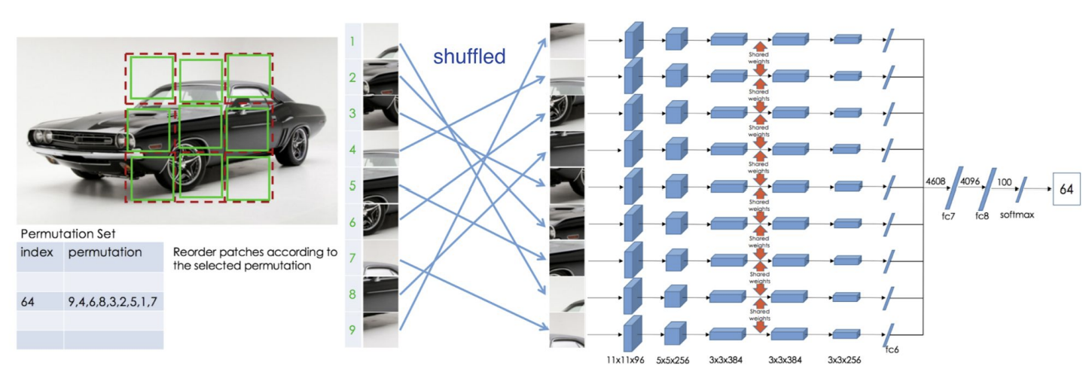
Pretext Task: solving “jigsaw puzzles”

Slide 8
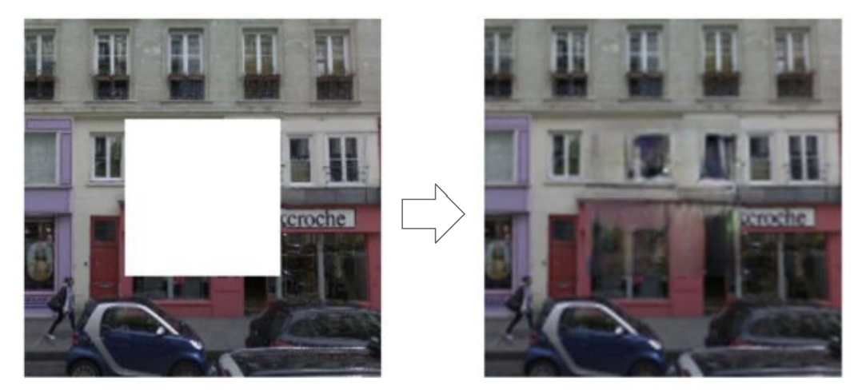
Pretext Task: predict missing pixels (inpainting)

Slide 9
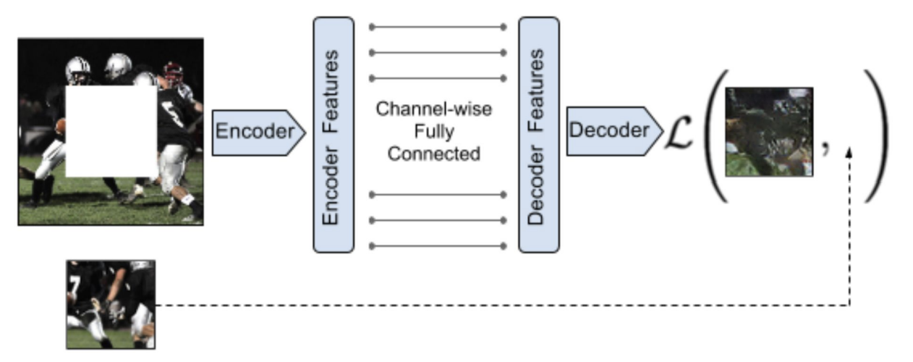
Pretest Task: predict missing pixels (inpainting)

Slide 10
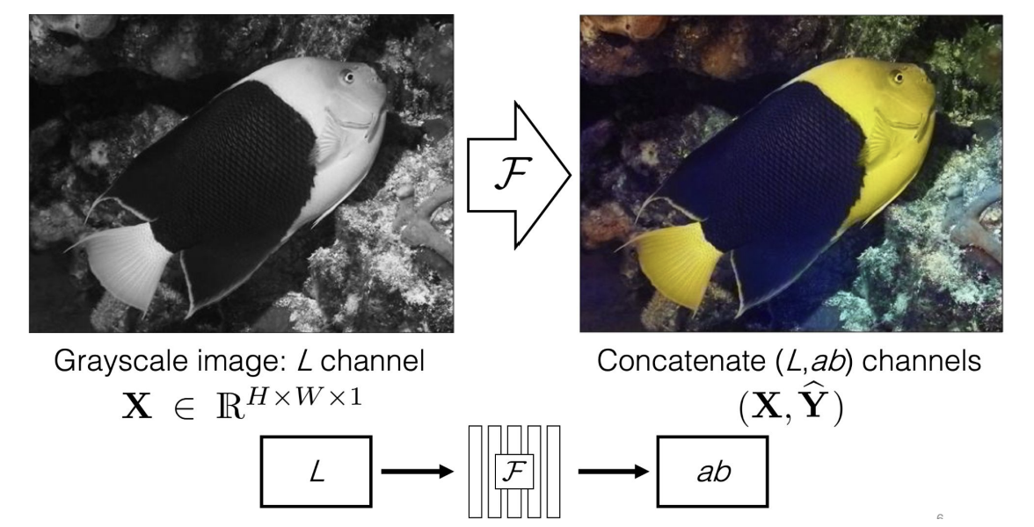
Pretext Task: image coloring

Slide 11
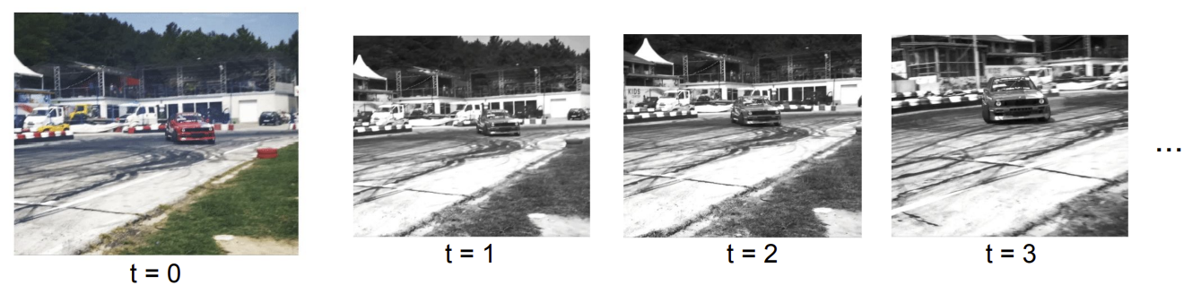
Pretext Task: video coloring
Model the temporal coherence of colors in videos
Reference Frame
Hypothesis: learning to color video frames should allow model to learn track regions or objects without labels.

Slide 12
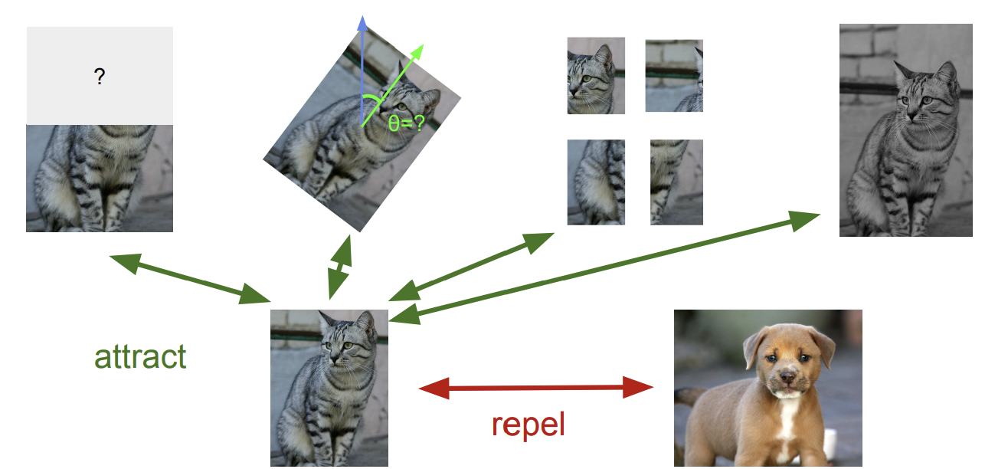
A more general pretext task
Learned representations from pretext tasks may be tied to a specific task.

Slide 13
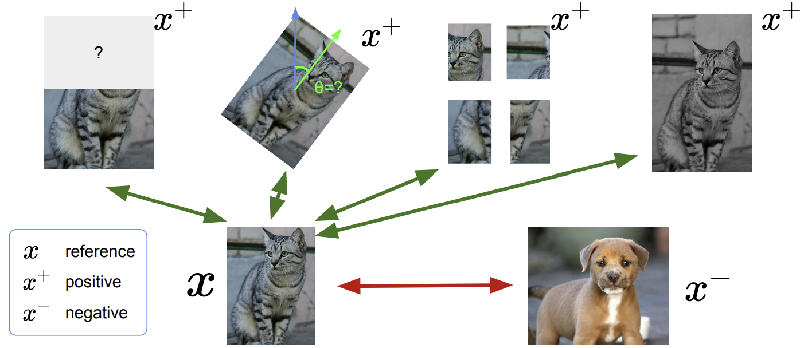
Contrastive Representation Learning

Slide 14
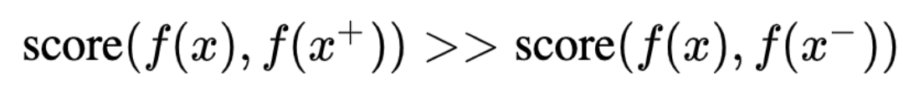
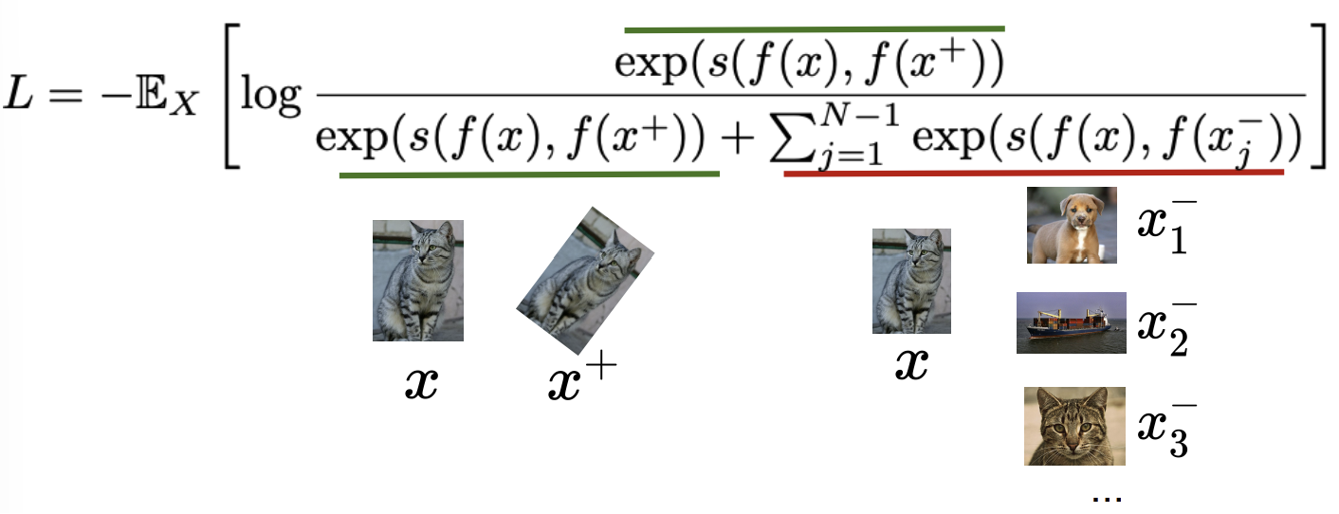
A formulation of contrastive learning
Objective:
Loss function (1 positive sample and N-1 negative samples)
⇒ Known as InfoNCE loss
⇒ Cosine similarity as the score function (usually)

Slide 15
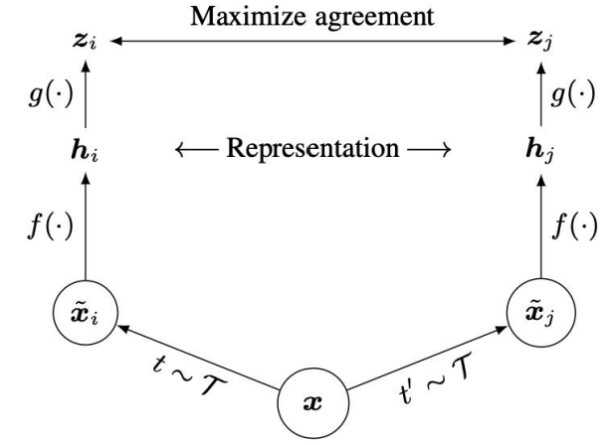
SimCLR: A Simple Framework for Contrastive Learning
⇐ A projection network to project features to a space where contrastive learning is applied
⇐ Generate Positive samples through data augmentation

Slide 16
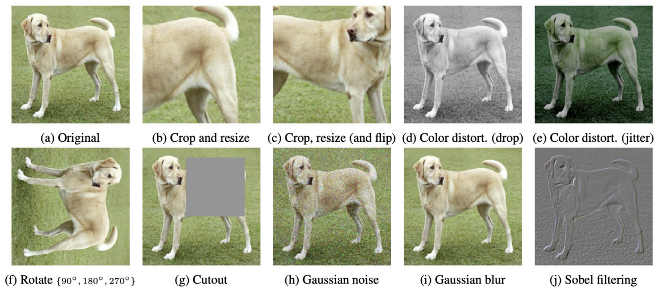
Data augmentation for SimCLR

Slide 17
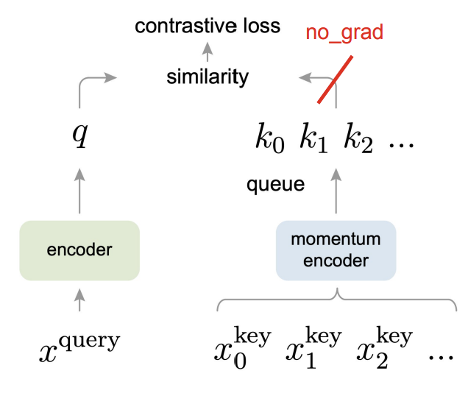
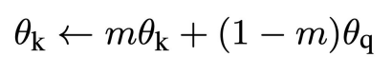
Momentum Contrastive Learning (MoCo)
Differences to SimCLR
Keep a running queue of keys with negative samples
Compute gradients and update the encoder only through the queries
Decouple mini-batch size with the number of keys, so that it can support large number of negative samples
The key encoder is slowly progressing through the momentum update rules:

Slide 18
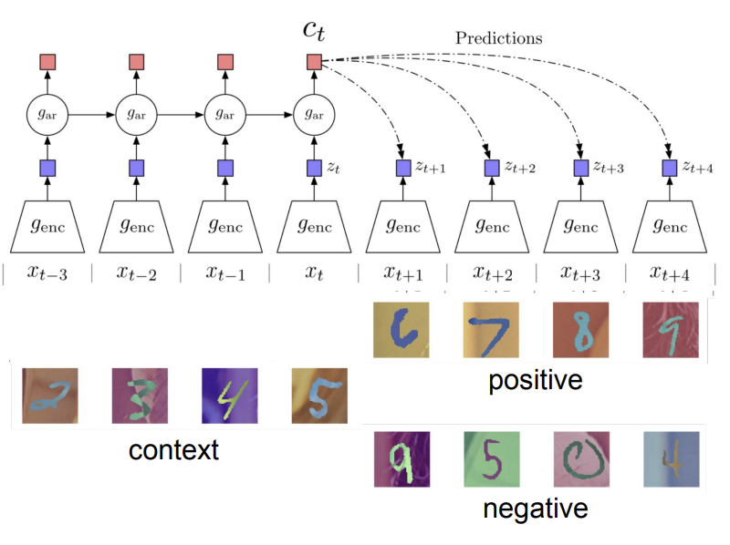
Sequence-level Contrastive Learning
ex) Contrastive Predictive Coding
Contrastive: contrast between “right” and “wrong” sequences
Predictive: the model has to predict future patterns given the current context.
Coding: the model learns useful feature vectors, or “code” for downstream tasks, like other self-supervised methods

Slide 19
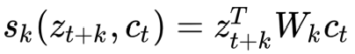
Sequence-level Contrastive Learning
ex) Contrastive Predictive Coding
Encode all samples in a sequence into vectors z_t
Summarize context into a context code c_t using an auto-regressive model g_ar
Compute InfoNCE loss between c_t and future code z_t+k using the following time-dependent score function

Slide 20
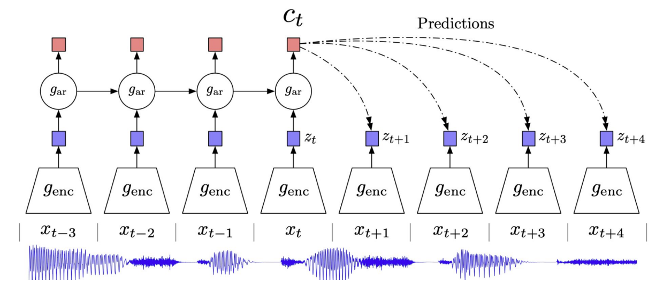
Example of CPC: audio sequence modeling

Slide 21
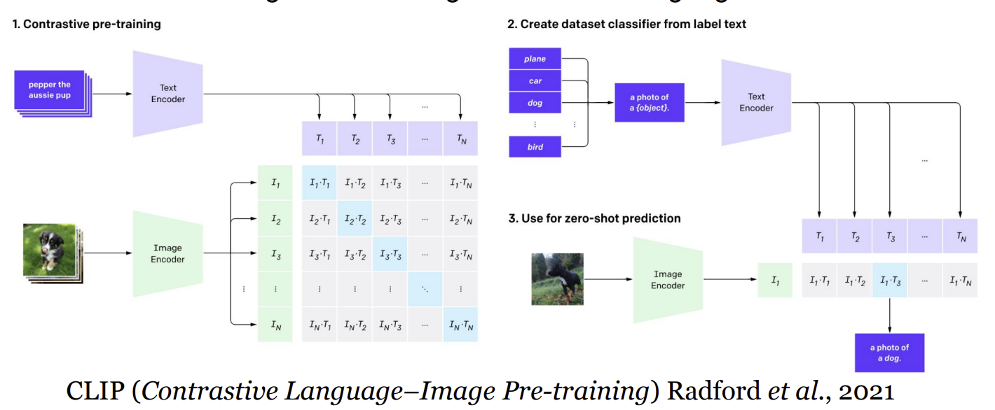
Contrastive learning between image and language

Slide 22
Any Questions?

